Slide 1
Introduction to SQL Query Tuning Agenda
Query Lifecycle
Reading query plans
Index Overview
Tuning Problem queries
Using SQL Profiler
Notes:
‹#›

Slide 2

Query Lifecycle
No
Plan in Cache?
Yes
Parse/Normalize
Retrieve Plan from Cache
Compile TSQL
Yes
Plan need to be recompiled ?
No
Optimize TSQL Statements
Wait for Memory Grant
Put Plan in Cache
Open (Activate Plan)
Run Plan to completion

Slide 3
Reading Query Plans
What does a plan tell us?
Access Methods(Seek/Scan)
Join Order
Join Types
Indexes(Clustered/Non Clustered) used
Sequence of operations
Estimated rowcounts, Actual rowcounts and costs for each step
Use of parallelism
Notes:
‹#›

Slide 4
Operators
Fundamental building blocks
Common Operators – Seek, Scan, Join, Aggregate, Top, Sort
Implements the Same Interface (OPEN, CLOSE, GETROW)
Single Basic Operation
1 Output, 0-N input
Command Flow – Left-> Right
Data Flow from Right-> Left
Non-blocking vs. blocking (Stop and Go) iterators
Some Needs Memory
Notes:
‹#›

Slide 5
SQL Server Index
An index helps SQL server to get to the data faster
Selectivity of an Index = Number of distinct values in the index/Total number of values
Preferable to have highly selective indices as SQL server uses indices only when it finds them useful
Statistics: Statistics are the data distribution histograms that SQL Server creates for Indices and other key columns to help with choosing the right query plan
Notes:
‹#›

Slide 6
Types of Indexes
Clustered Indexes
Non Clustered Indexes

Slide 7
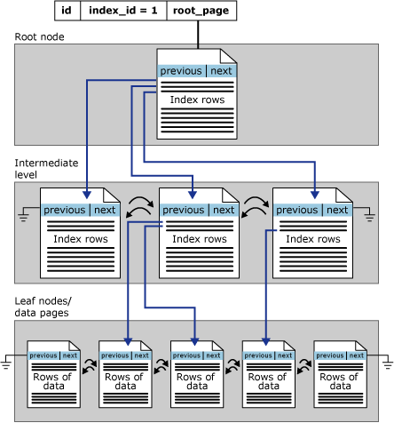
Clustered Indexes
Sort and store the data rows in the table or view based on their key values.
There can be only one clustered index per table
The only time the data rows in a table are stored in sorted order is when the table contains a clustered index.
A table with clustered index, is called a clustered table.
In a table without clustered index, data rows are stored in a heap.
Notes:
‹#›
Clustered indexes sort and store the data rows in the table or view based on their key values. These are the columns included in the index definition. There can be only one clustered index per table, because the data rows themselves can be sorted in only one order.
The only time the data rows in a table are stored in sorted order is when the table contains a clustered index. When a table has a clustered index, the table is called a clustered table. If a table has no clustered index, its data rows are stored in an unordered structure called a heap.

Slide 8
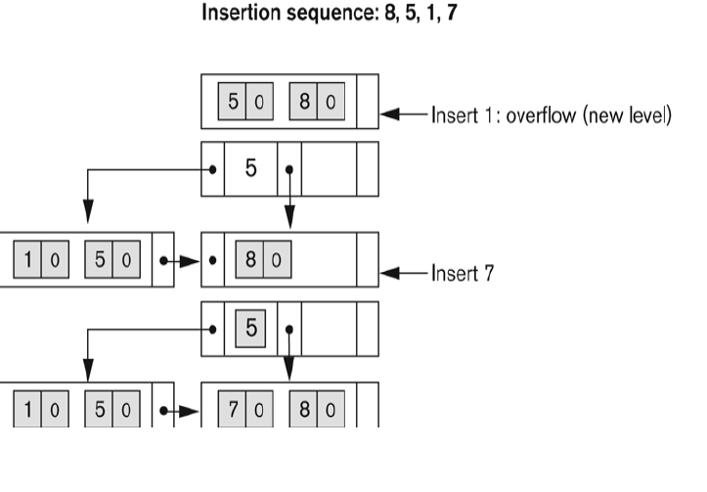
Clustered Index insertion sequence
Notes:
‹#›

Slide 9
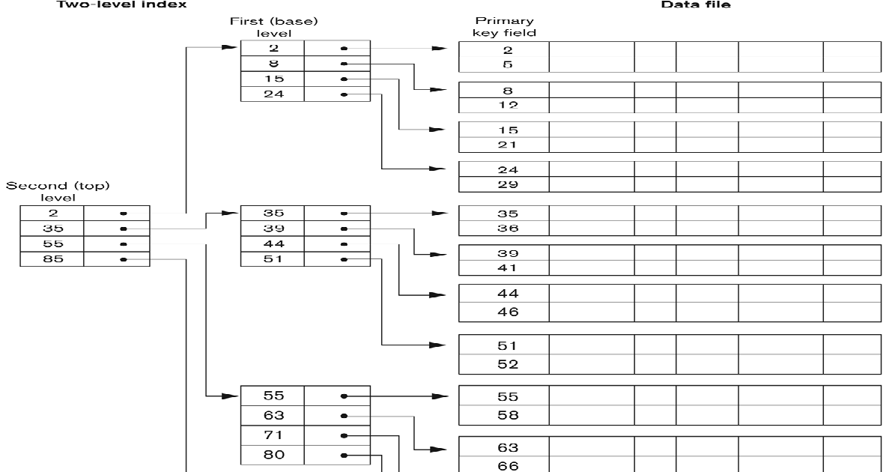
Clustered B Index Tree

Slide 10
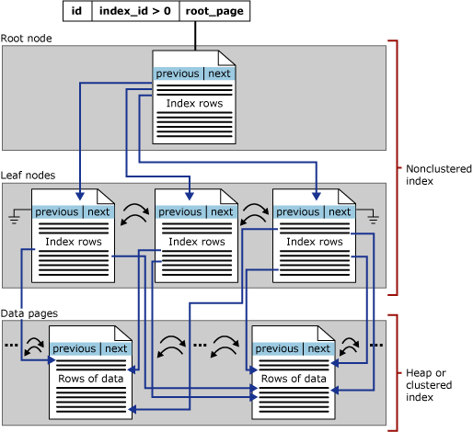
Non Clustered Indexes
Have structure separate from the data rows.
A nonclustered index contains the nonclustered index key values and each key value entry has a pointer to the data row that contains the key value.
The pointer from an index row in a nonclustered index to a data row is called a row locator.
The row locator can be a pointer to the row or the clustered index key.

Slide 11

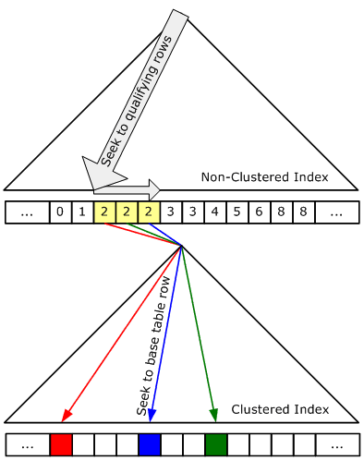
Bookmark lookup(Key Lookup)
Bookmark lookups are a mechanism to navigate from a non-clustered index row to the actual data row in the base table (clustered index/heap)
Look up the extra columns in the heap or clustered index based on the Clustered Index key/RID
Costly because of Random IO
Implemented using Nested Loops in SQL 2005 and Above
Notes:
‹#›

Slide 12

Nested Loop Joins
Nested Loop: Best strategy for joining small tables. It cycles through the outer (hopefully, smaller table) then searches for matches in the inner table.
The complexity of a nested loops join is proportional to the size of the outer input multiplied by the size of the inner input
Nested loops join generally performs best for relatively small input sets.
for each row R1 in the outer table for each row R2 in the inner table if R1 joins with R2 return (R1, R2)
Notes:
*
© 2004 Microsoft Corporation. All rights reserved.
This presentation is for informational purposes only. Microsoft makes no warranties, express or implied, in this summary.
‹#›

Slide 13

Merge Joins
Merge: Best strategy for large, similarly sized tables that are sorted. It takes a row from each table and directly compares them.
Requires at least one equijoin predicate
Data must be sorted on the join keys
Sort order may be provided by an index
Or, plan may include an explicit sort
Basic algorithm:
Get one row from both the left and right inputs
If the rows match, return the joined row
Otherwise, get a new row from whichever input is smaller and repeat (Algorithm for union of two data sets)
Notes:
*
© 2004 Microsoft Corporation. All rights reserved.
This presentation is for informational purposes only. Microsoft makes no warranties, express or implied, in this summary.
‹#›
Both Require Equi-Join

Slide 14

Hash Joins
Hash: Best for large, dissimilarly sized tables or those without a useful index and other special operations. It builds a hash table of both inputs
Two phases: Build and Probe, Uses Memory, Stop and Go
Equijoin Required
for each row R1 in the build table begin calculate hash value on R1 join key(s) insert R1 into the appropriate hash bucket end for each row R2 in the probe table begin calculate hash value on R2 join key(s) for each row R1 in the corresponding hash bucket if R1 joins with R2 return (R1, R2) end
Notes:
*
© 2004 Microsoft Corporation. All rights reserved.
This presentation is for informational purposes only. Microsoft makes no warranties, express or implied, in this summary.
‹#›
Add 2 more points Hash, Nested Loop

Slide 15
Demo

Slide 16
SQL Best Practices
Push predicates deeper into the plan
Reworking SELECT *
Using Sargs
Minimize bookmark lookups
Use Index columns for ordering
Frequently used aggregates should be in a covered index

Slide 17
Questions?

Slide 18
Thank you

Slide 19
References
Books
Professional SQL Server 2005 Performance Tuning – Wrox Publication
Inside SQL Server 2005 – Query Tuning and Optimization – Microsoft Press

